Slide 1
Stvori matematiku!
Hiperbolni paraboloid

Slide 2
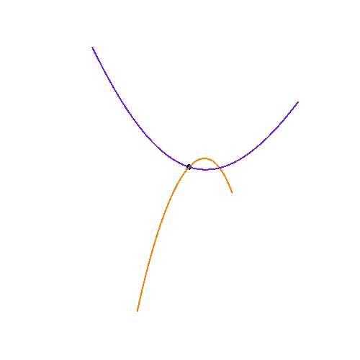
Hiperboloidni paraboloid - HIPAR

Slide 3
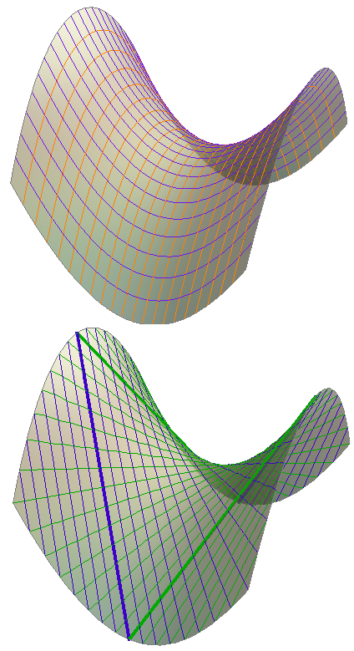
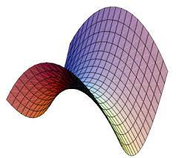
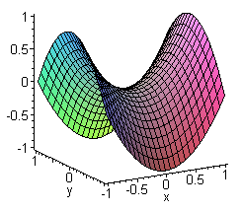
Hipar s iscrtanim sustavom parabola i pravaca

Slide 4
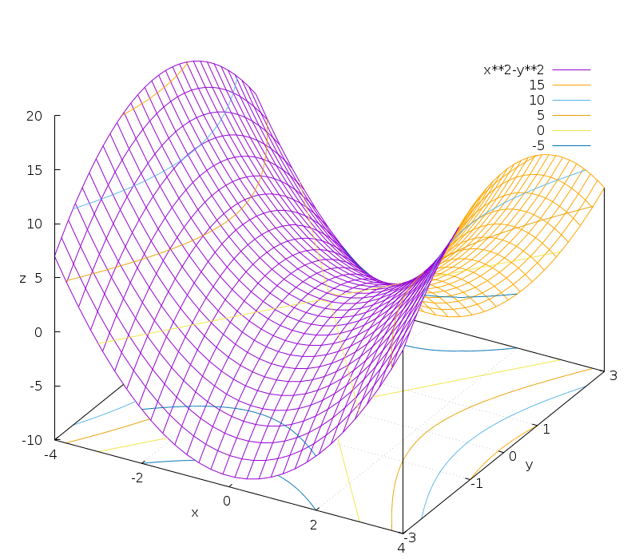
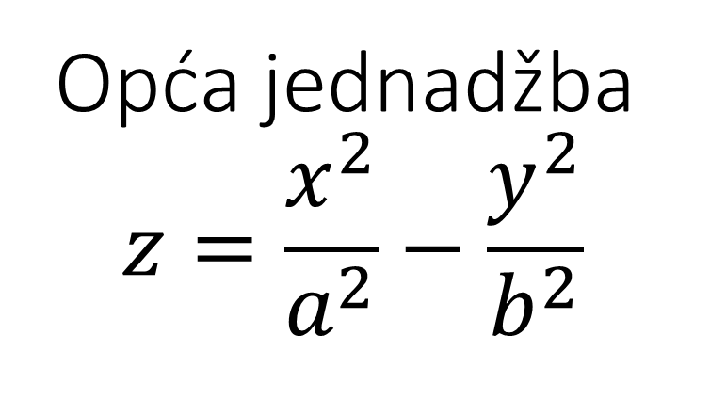
Opća jednadžba
$$z=\frac{x^{2}}{a^{2}}−\frac{y^{2}}{b^{2}}$$

Slide 5
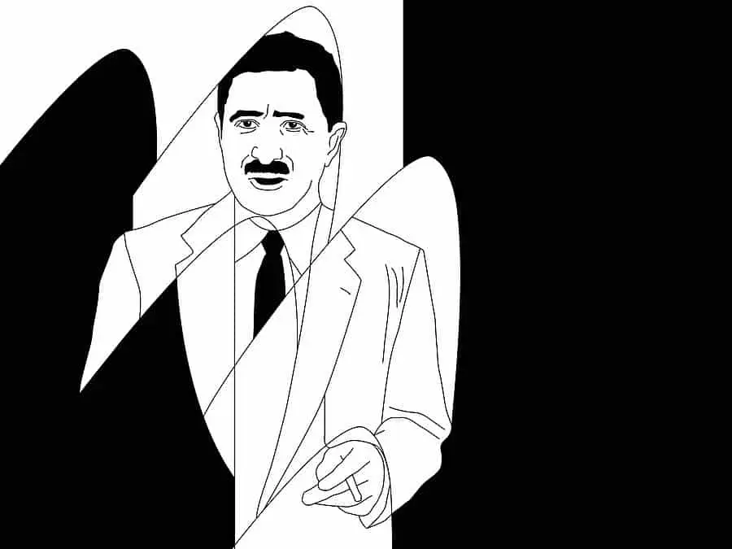
Felix Candela – Čovjek koji je stvarao valove

Slide 6
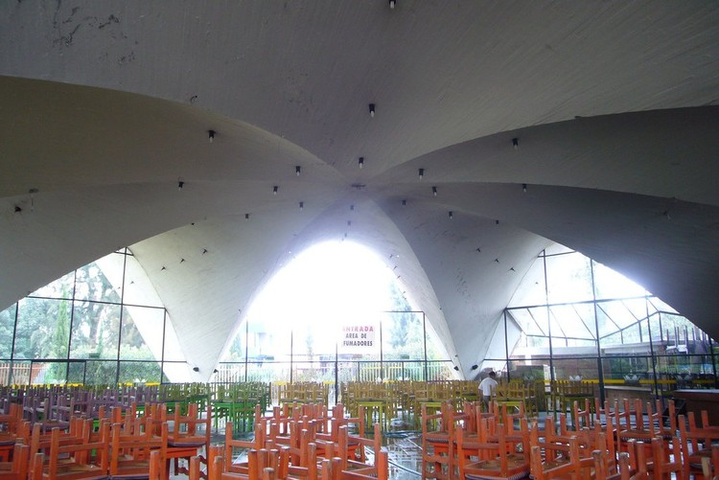
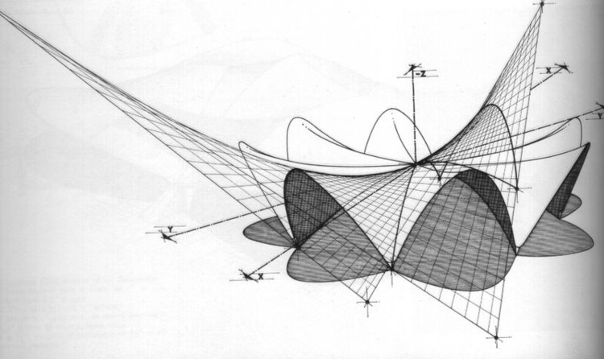
Arhitekt: Félix Candela
Lokacija: Calz. Xochimilco-Tulyehuealco 60 boja Nativitas 16450, Mexico City
Godina projekta: 1958.
Restoran Los Manantiales

Slide 7
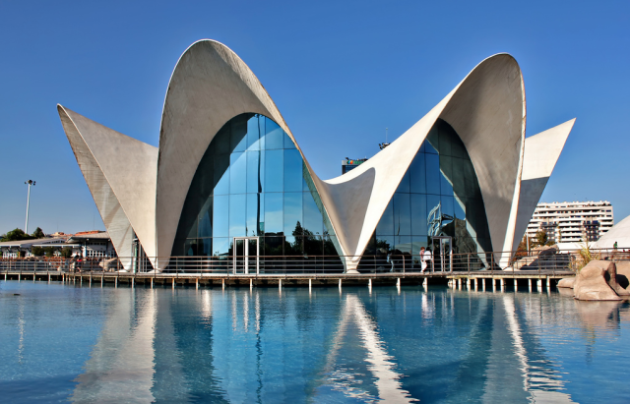
L'Oceanogràfic, Valencia – Grad znanosti i umjetnosti

Slide 8
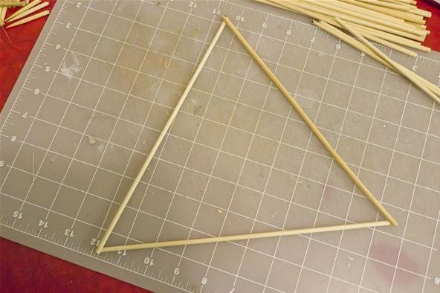
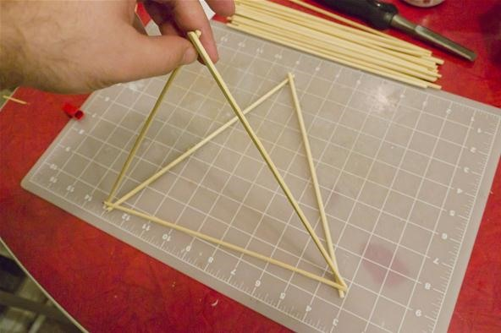
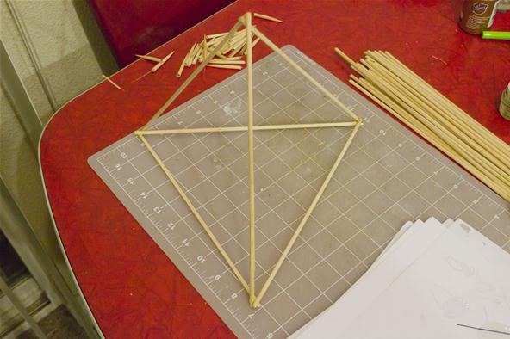
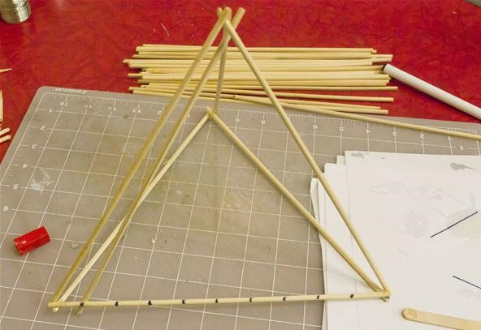
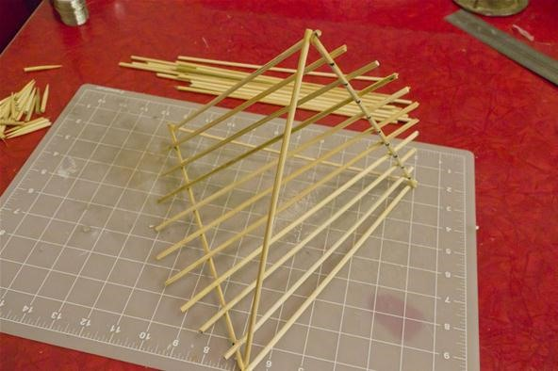
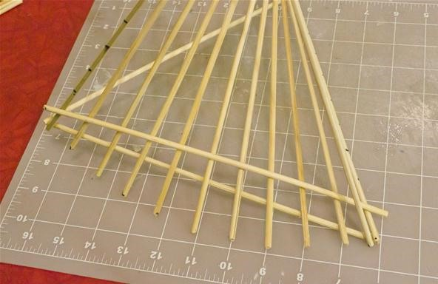
Stvori HIPER!

Slide 9
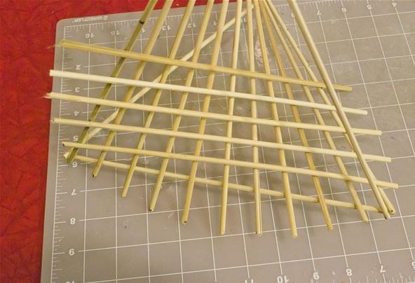
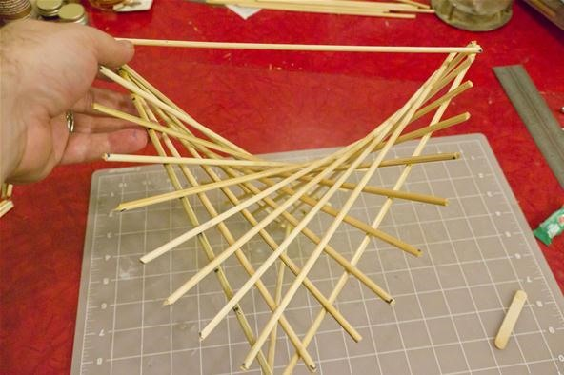

Slide 10
Literaratura
https://web.math.pmf.unizg.hr/~krcko/nastava/la/hiperpara.html
http://erikdemaine.org/hypar/
http://lavica.fesb.hr/mat2/predavanja/node57.html
https://nmd.web.illinois.edu/quadrics/hypparab.html
https://www.formlinermag.com/en/the-man-who-made-waves/
https://en.wikipedia.org/wiki/Gold_Medal_of_the_Institution_of_Structural_Engineers
https://www.archdaily.cl/cl/02-95859/clasicos-de-arquitectura-restaurante-los-manantiales-felix-candela
https://www.spain.info/en/leisure-parks/oceanografic-city-arts-sciences/
https://mathcraft.wonderhowto.com/how-to/make-hyperbolic-paraboloid-using-skewers-0131751/

